Slide 1
CS Club Weekly Meeting <3
02-14-21

Slide 2
Agenda
Textbook Story Survey
Announcements
The plan for this semester!

Slide 3
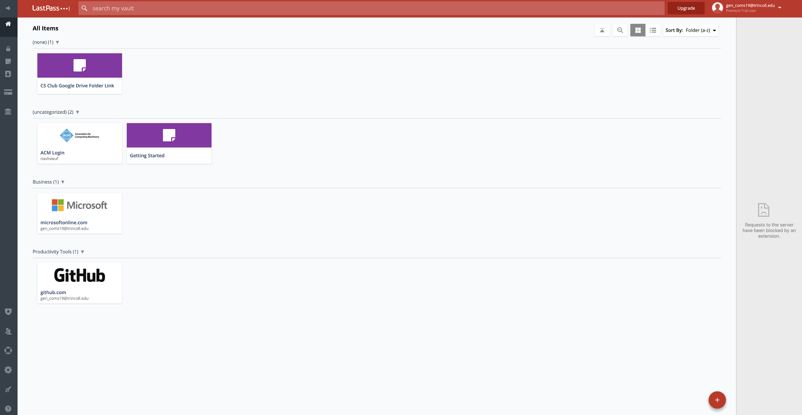
CS Club Has Created a LastPass

Slide 4
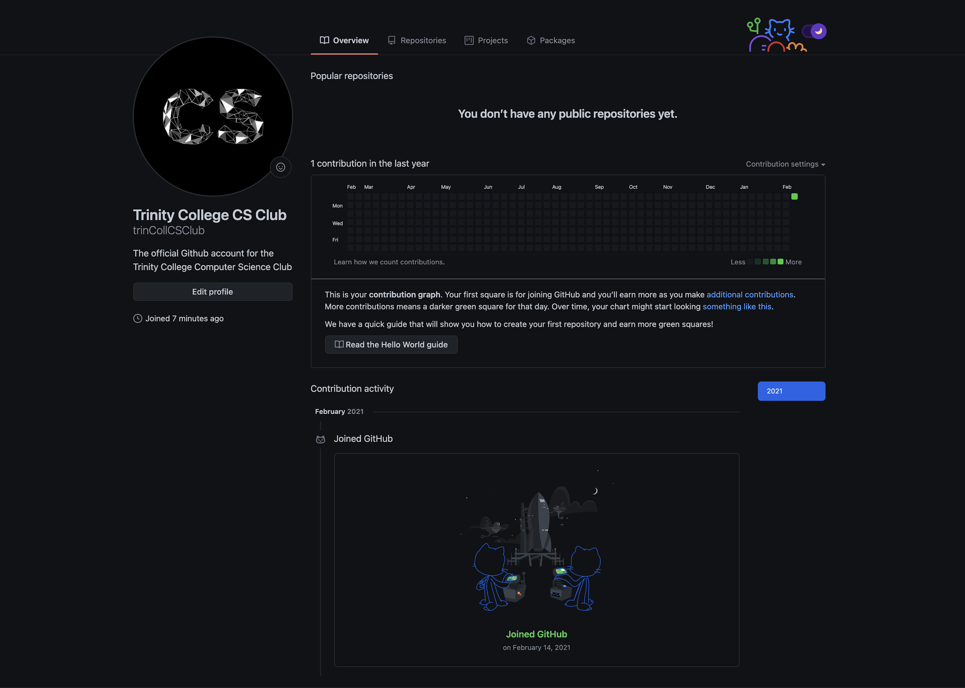
New GitHub
(feel free to go follow :))

Slide 5
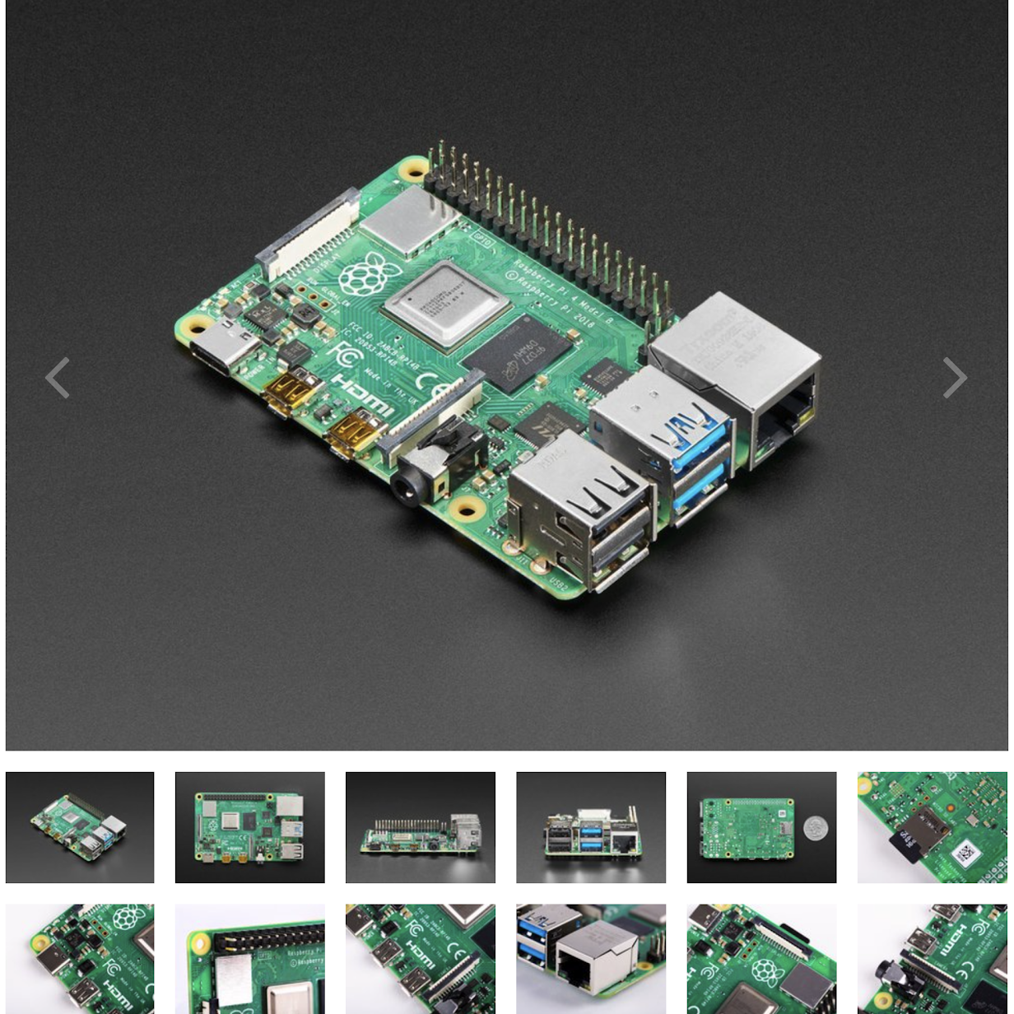
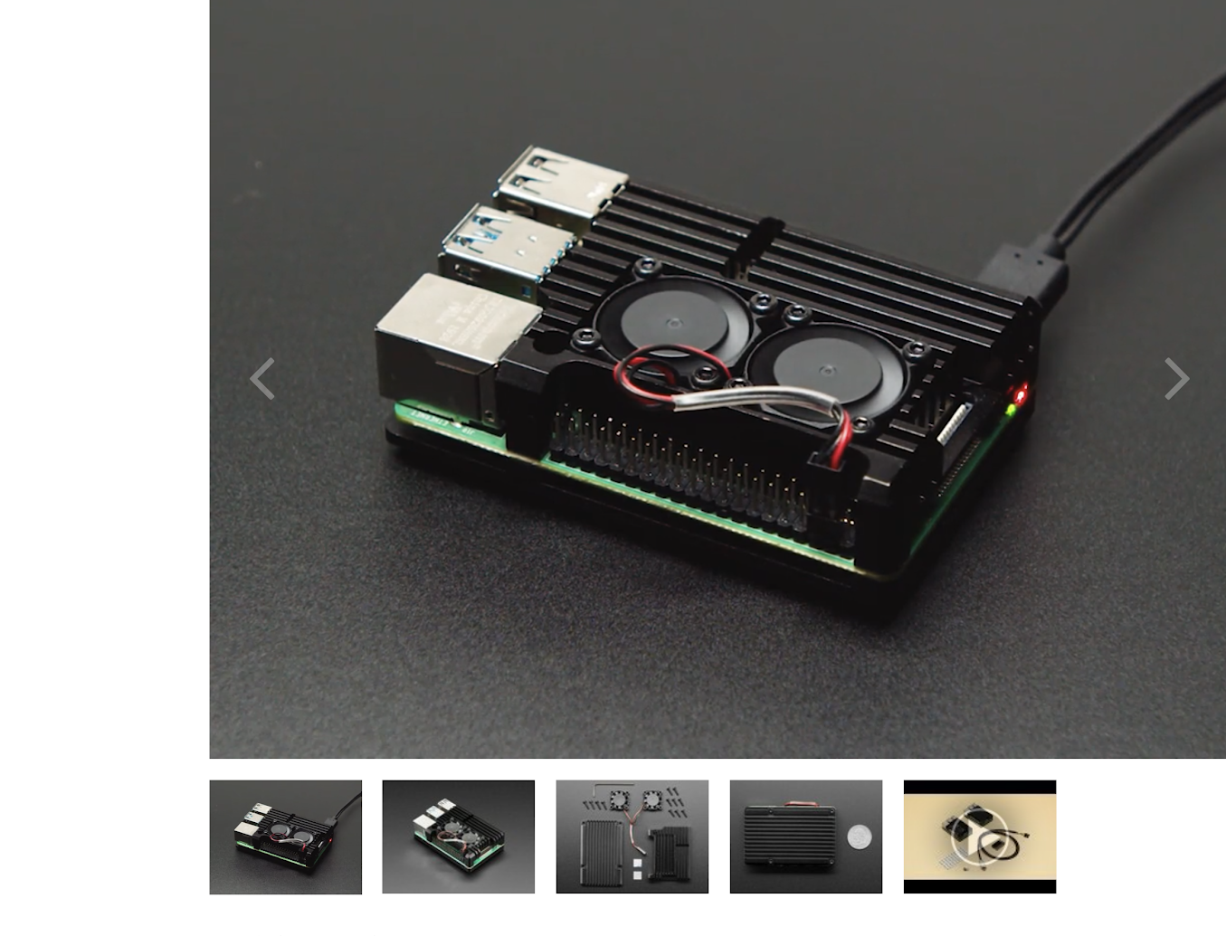
New Hardware (Hopefully)

Slide 6
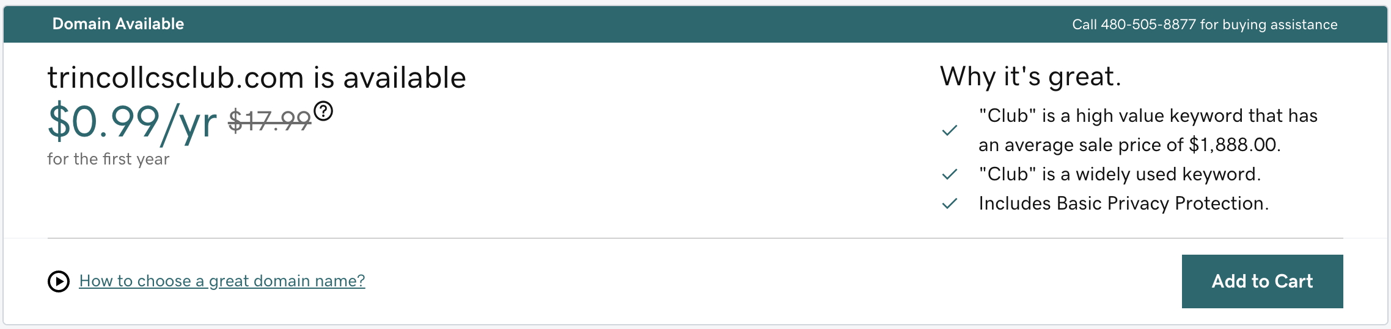
CS Club Spring 2021 Full-Stack Initiative

Slide 7
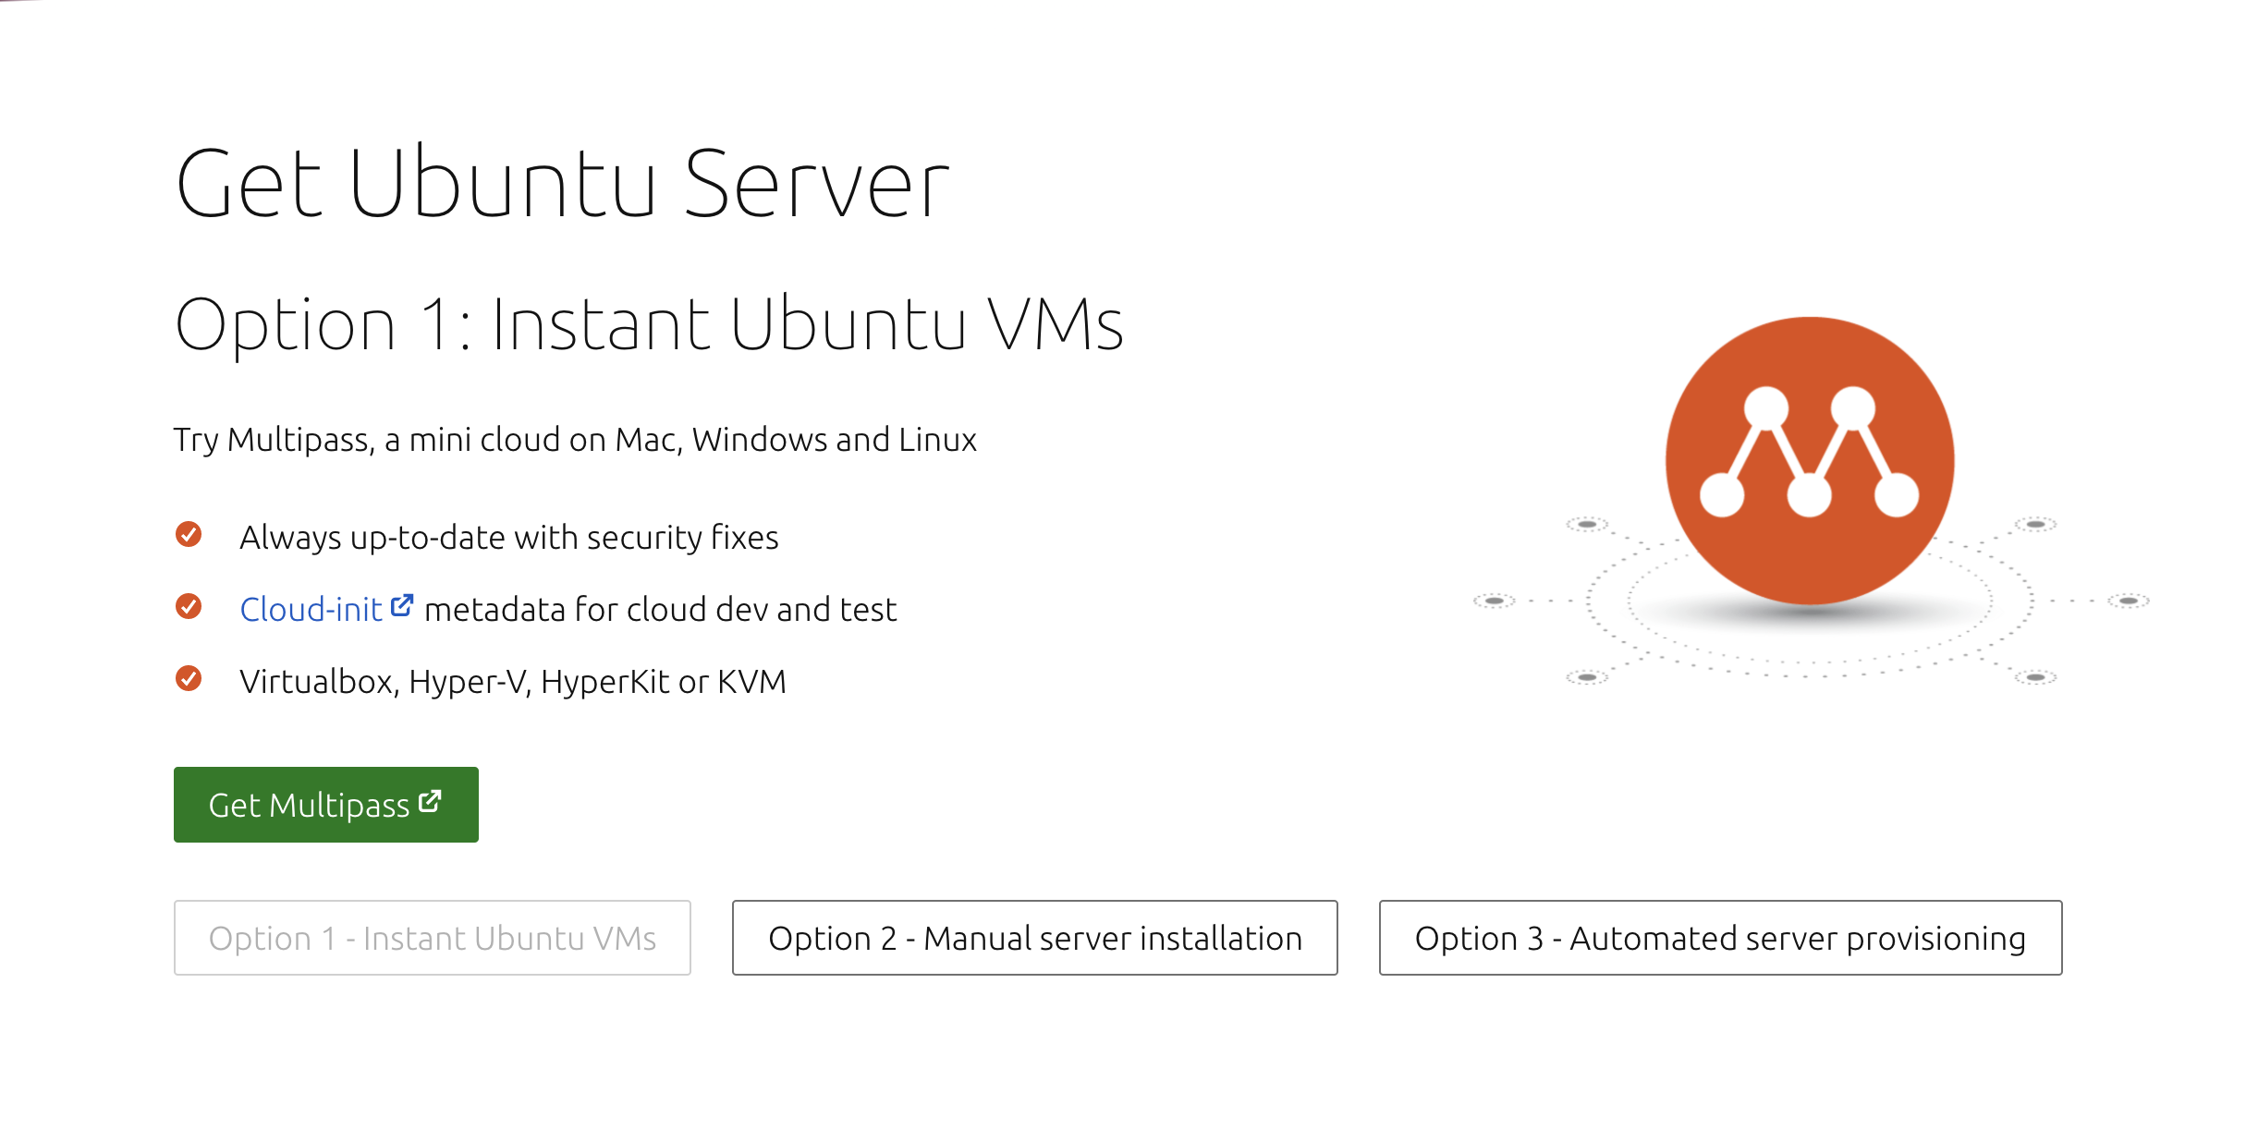
CS Club Spring 2021 Full-Stack Initiative

Slide 8
CS Club Spring 2021 Full-Stack Initiative
Other Technologies and Concepts we will explore
Creating Pull Requests in Github
Python Flask
JavaScript
Webhooks
How to properly organize a repository for frontend/backend development
Clean Code
Documentation
Continuous Integration and Continuous Development (CI/CD) principles
Much More!

Slide 9
Now for Some Light Coding

